Slide 1

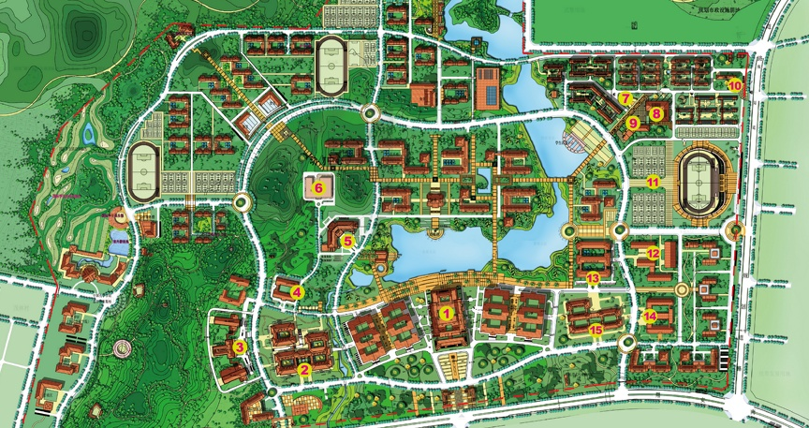

Developing Energy Integration Strategies for Smart Urban Parks
Dr. Yingru Zhao（赵英汝）
Institute for Energy Efficiency Engineering, SER-XMU
Sino-German Workshop, 21-27th June 2014, Xiamen, China
Notes:
It is very hard to define the

Slide 2
Outline
An Overview of IEEE
Smart Urban Park Activities - Update on China
Smart Urban Park R&Ds at IEEE
Opportunities for Collaboration
Conclusions

Slide 3
Outline
An Overview of IEEE
Smart Urban Park Activities - Update on China
Smart Urban Park R&Ds at IEEE
Opportunities for Collaboration
Conclusions

Slide 4
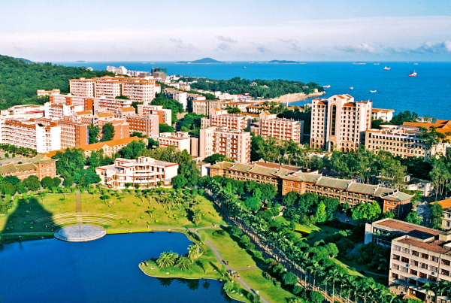


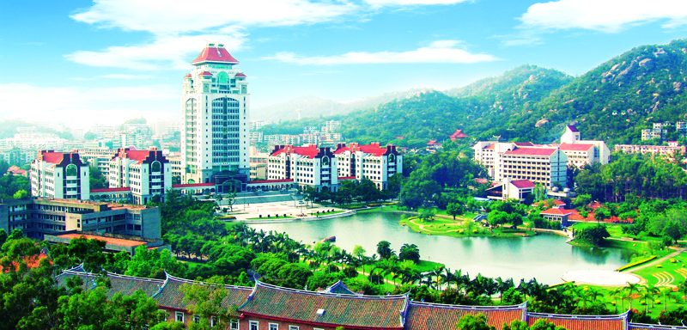
Xiamen University (XMU)
One of the Top 20 universities in China
Founded in 1921 by an overseas Chinese - Tan Kah Kee
Very strong in chemistry, ocean science, economics & accounting
Notes:
the most beautiful campus in China。Three campuses.
The university now has a total number of 38,000 full-time students on campus, over 2500 international students

Slide 5
School of Energy Research (SER)
Technology
Maturity
Test & Commissioning
 |  |  |  |  |  |  |  | 9
 |  |  |  |  |  |  | 8
 |  |  |  |  |  | 7
 |  |  |  |  | 6
 |  |  |  | 5
 |  |  | 4
 |  | 3
 | 2
1
System/subsystems
Companies
Demonstration
Development
Feasibility
Basic Research
Colleges
Time
5
Notes:
Our school if founded in 2007. We now have over 40 full time faculty members.
If you look at the TRL (Technology readiness levels), most universitites are located between TRL 1-3, most companies are between 7-9, we are somewhere between 4-6, that’s why we have a lot of development and Demonstration projects with our industrial partners.
Last year, we have announced the formation of a (regioanl) new energy industry to bring technologies, people, capital and market together.

Slide 6
School of Energy Research (SER)
SER is consisted of 5 institutes and 1 center
Institute for Advanced Nuclear Energy
Institute for Chemical Energy
Institute for Bio-energy
Institute for Solar Energy
Institute for Energy Efficiency Engineering
Center for Energy Economics Research
SER has 5 Ph.D. programs and 1 UG program
Nuclear Science and Engineering
Energy Chemistry
Photovoltaic Engineering
Energy Efficiency Engineering
Energy Economics
New Energy Science and Engineering
Notes:
Our school conduct research and develop technologies in Advanced Nuclear Energy, Solar Energy, Chemical Energy, Bio-energy, Energy Efficiency Engineering (First EEE postgraduate programme in China - MOE approved )and Energy Economics.

Slide 7
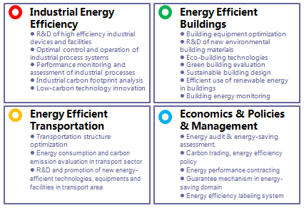
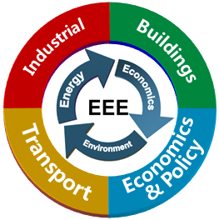
IEEE
First EEE postgraduate program in China – MOE authorized
Notes:
EEE is an interdisciplinary research and applied science, the wide ranging research in the Institute has been grouped into four focus areas: Industrial, Buildings, Transportation, Economics & Policy and Management.We now have 6 faculty members, plus 7 postgraduates (1 Ph.D & 6 master students.
And therefore, the institute works extensively with the government and industries.

Slide 8
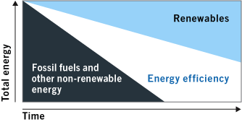
Why Energy Efficiency?
“Energy efficiency provides us with the time needed to replace fossil fuels and other non-sustainable energy sources with renewables in an ecological, economic and socially responsible manner…”
——cited from IEA

Slide 9

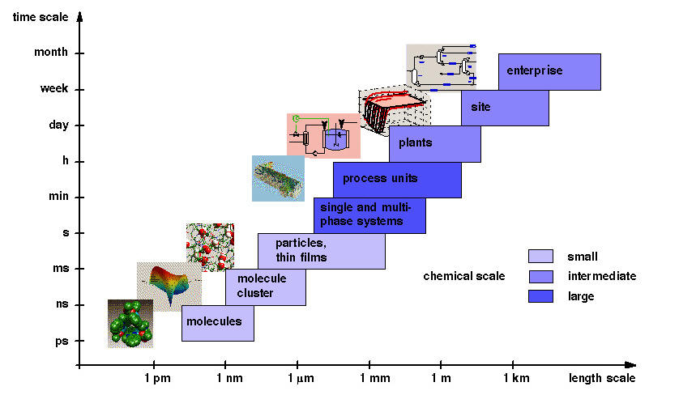
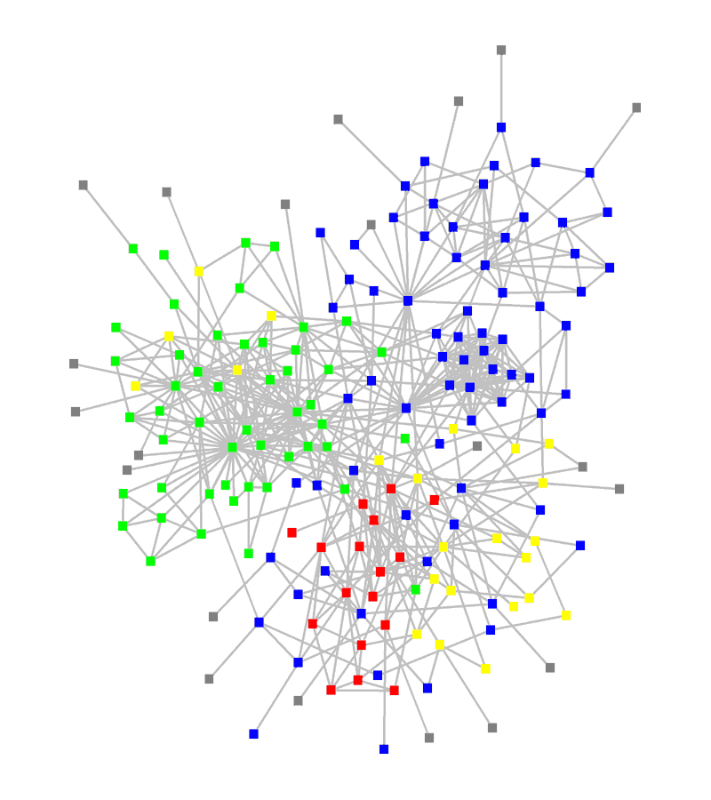
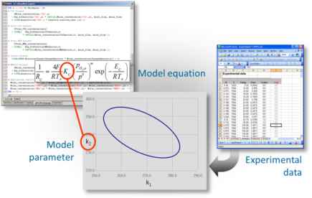
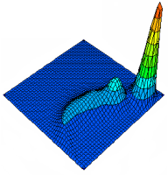

IEEE - Mission
Conduct and promote R&D in energy efficiency across different sectors in the planning, design, implementation, management and assessment of energy chain.
Develop and improve opportunities for advanced energy efficient technologies, systems and practices, with an emphasis on economically and environmentally attractive deployment.
network and
value chain
Notes:
The work being carried out in my team at IEEE is a whole-systems analysis of multi-scale energy systems. That is, every relevant time and length scale is considered in our work. Our approach to tackle this challenge is through Multiscale predictive models that are developed with different computer tools and softwares like gPROMS.

Slide 10
Outline
An Overview of IEEE
Smart Urban Park Activities - Update on China
Smart Urban Park R&Ds at IEEE
Opportunities for Collaboration
Conclusions
Notes:
smart cities and Intelligent Communities

Slide 11

SETTING THE SCENE
China urbanization rate will reach 70%
Urban population will reach 1000 million by 2030
At least 350 million more people will move to cities in the next 20 years
660 cities and 2000 new towns and satellite cities are built and rebuilt in the next 20 years
China urbanization rate will reach
70%
Urban population will reach
1 billion by 2030
At least 350 million more people
will move to the city in the next 20 years
660 cities and 2,000 new towns and
satellite cities will be built and rebuilt in the next 20 years
Notes:
The urbanization in China is currently undergoing rapid development. In the next two decades, an additional 350 million people, which is the entire US population, will move to an urban environment, bringing the total urban population in China close to one billion. It is estimated 660 new cities and 2,200 new towns will be built. This urbanization poses extraordinary challenges not to only to China, but also to the world.
At present, the proportion of permanent urban residents to China's total population stands at 53.7 percent, lowerthan developed nations' average of 80 percent, and 60percent for developing countries with similar per capitaincome levels as China.

Slide 12
Key Numbers
Permanent urban residents rose from 17.9 percent of the total population in 1978 to 53.7 percent in 2013.
By 2020, 100 million migrant workers and other permanent urban residents should get city “hukou” (household registration).
There were almost 270 million migrant workers in China at the end of 2013.
Regular railways will connect all cities with more than 200,000 residents by 2020, and high-speed rail will connect those with above 500,000 residents.
Expressways will link cities with over 200,000 residents by 2020.
Civil aviation services will cover about 90 percent of China’s population
Notes:
What does new urbanization mean and what are the implications to businesses and individuals?

Slide 13
National Strategy - Government Policy
Policy priority by new government: urbanization progress shall be accelerated focusing on sustainable development as the priority
NEA: new energy city listed in 12th Five Year (2011-2015) RE Plan
100 new energy cities, 1000 new energy demon parks (city level)
200 green energy counties (rural level)
Objective: promote new energy technologies scale-up in both cities and rural areas in order to achieve sustainable development
Instructive Opinions on a Robust Development of Smart Cities jointly drafted by eight ministries in July 2013
…smart transportation, smart grid, smart water treatment, smart environmental protection, smart medical system, smart pension system, smart home, smart education, smart territory…
Notes:
China has a strategy to develop Smart Cities and urban areas for the year 2011-2015.
As outlined in our country’s “12th Five Year (2011-2015) RE Plan ”which is issued by NEA (The National Energy Administration ), new energy city was included in the priority themes.The government plans to have 100 new energy demonstration cities by 2015. (NEA) recently called for applications to establish new energy demonstration cities (NEDCs) and industrial parks.
in July 2013, Instructive Opinions on a Robust Development of Smart Cities jointly
drafted by eight ministries to enhance the supervision over local smart city
projects, improve the strategic planning of smart city development, and create a
coordinated order of administration.
What is new energy city?
RE CONSUMPTION share improved to a maximum level in cities, but at least 6% of the total energy consumption in local

Slide 14
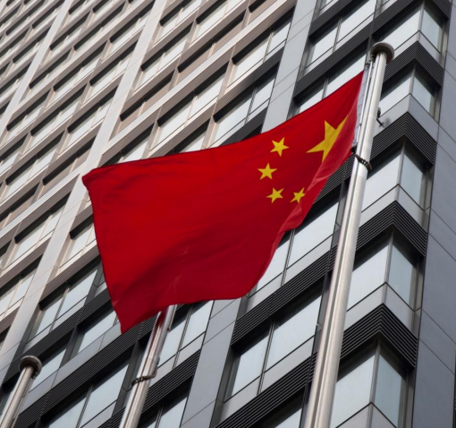
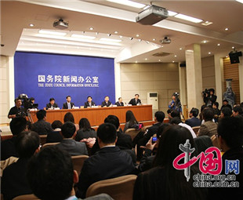
National Strategy - Government Policy
National New-type Urbanization
Plan (2014-2020) issued by the Central Committee of the Communist Party of China (CPC) and the State Council officially on 16 March 2014.
Approximately RMB42 trillion (USD6.75 trillion) will be required to finance China’s urbanization efforts over the next seven years.
Macroscopic, strategic and fundamental plan.
China's first plan on urbanization enacted by the central authorities.
Notes:
In addition to that, two months ago the government officially issued the "National Plan on New Urbanization.“. It is a macroscopic, strategic and fundamental plan, and it is also China's first plan on urbanization enacted by the central authorities. The plan is for the 2014-2020 period. It show an effort to steer the country's urbanization onto a human-centered and environmentally friendly path.
It will serve as a guideline for China’s urbanization.

Slide 15
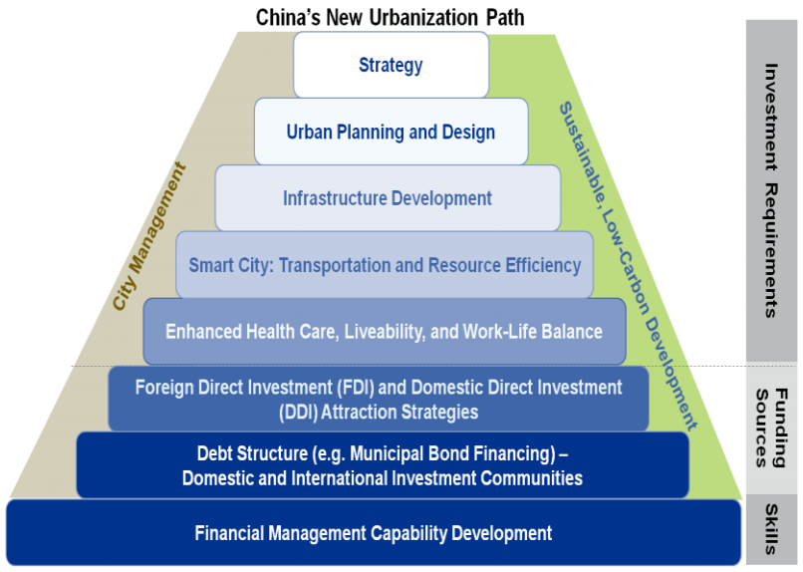
National Strategy (2014-2020)
Notes:
How do we achieve these targets and implement this plan? Basically you need national strategy which we already have one, and based on that strategy, urban planning and design is a priority. …. Plus the funding schemes and investment strategies. Last but not least, financial management capability development is also needed.

Slide 16
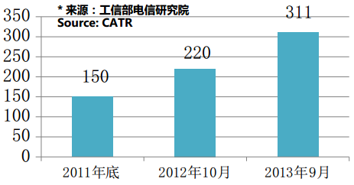
Smart City Development in China
By last September, 311 cities in China proposed or started smart city projects
100% deputy-provincial level cities
89% of regional-level cities
47% county-level cities
52 cities nationwide of the regional level or above formally proposed smart city projects during their 2013 Government Work Report or the Twelfth FYP for National Economy
23 cities (e.g. Beijing, Guangzhou, and Tianjin) formally announced special planning or action plan on smart city
Notes:
here is a bar chart of the smart city development projects in China.

Slide 17
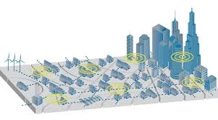

What is a Smart Urban Park?
Smart
Energy
Management
Intelligent
Water
System
Intelligent
Transportation
Waste
Management
Efficient
Logistics
Information Communication Technology
Notes:
What make an urban park smart? In my understanding, there are Six Elements to support “Smart” Urban Park.

Slide 18
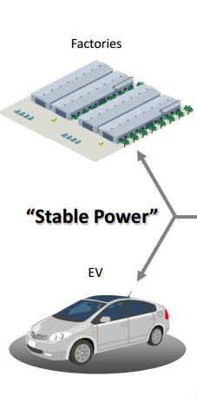
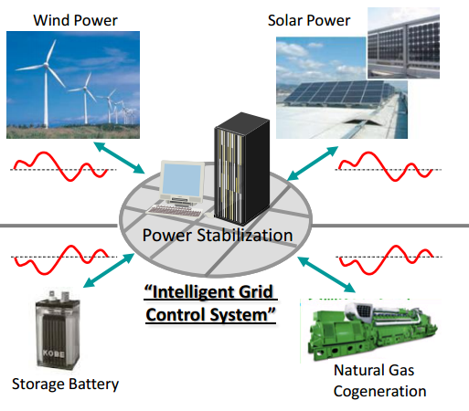
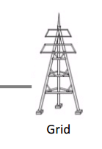
Smart Energy Management
Demand
Supply
Smart Energy Management = Renewable Energy + Power Stabilization
Notes:
Take the industrial park for example,

Slide 19
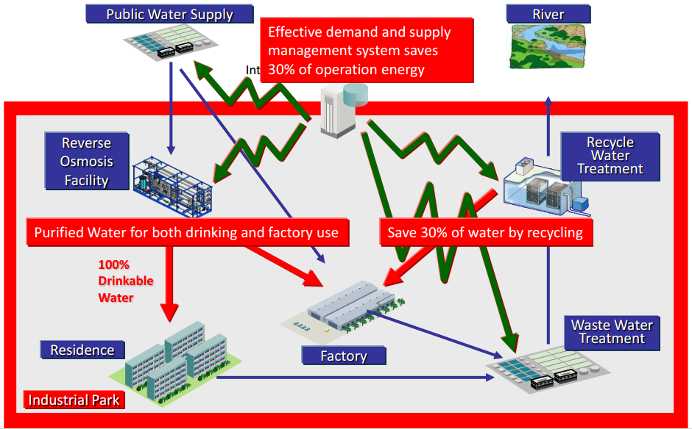
Intelligent and Efficient Water System
Notes:
Which means that the park should have a Low Water Leakage Rate and a High Water Recycle Rate
Efficient water distribution and reuse are critical in areas where water resource is limited.
Japan leads the world in efficient water usage, whose Water Leakage Rate is 3.1% while in China this number is 15.6%。And its Industrial Water Recycle Rate is as high as 80%, while in Chins it is only 50%.
Reverse osmosis (RO) is a water purification technology that uses a semipermeable membrane.

Slide 20
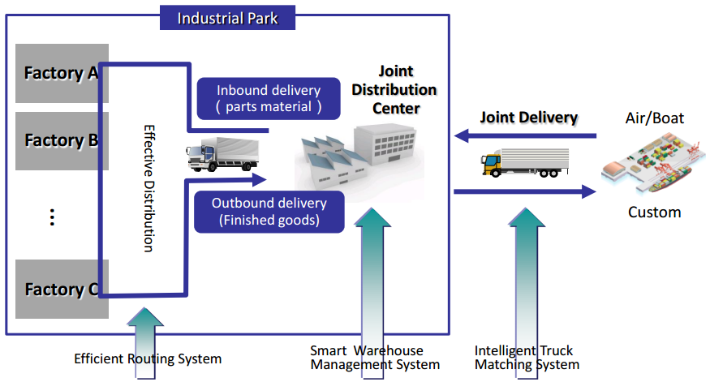
Efficient Logistics
ICT System
Notes:
“Smart” industrial park does not simply mean smart manufacturing factories. It must also be“Smart”and efficient logistic park.
Logistics is the management of the flow of goods between the point of origin and the point of consumption in order to meet some requirements, for example, of customers or corporations. The resources managed in logistics can include physical items, such as food, materials, animals, equipment and liquids, as well as abstract items, such as time, information, particles, and energy. The logistics of physical items usually involves the integration of information flow, material handling, production,transportation, and often security

Slide 21
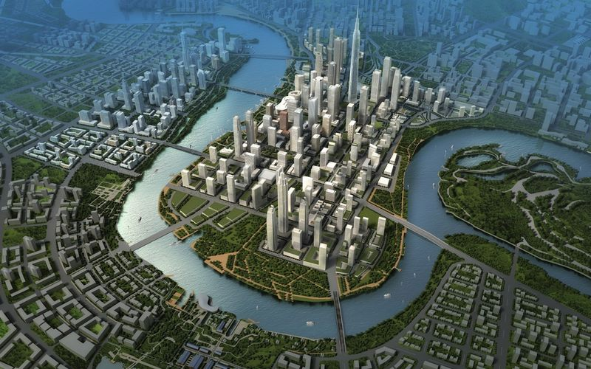
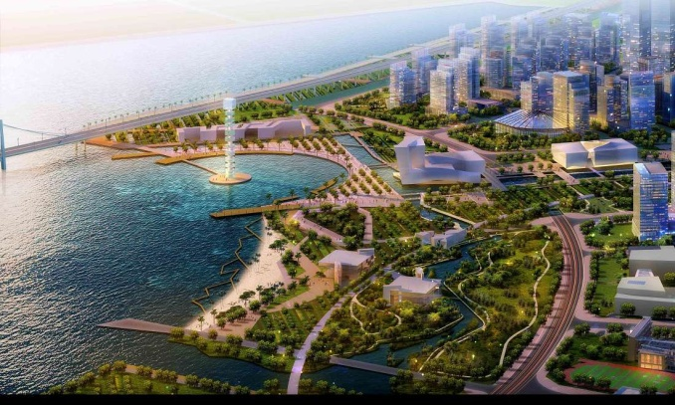
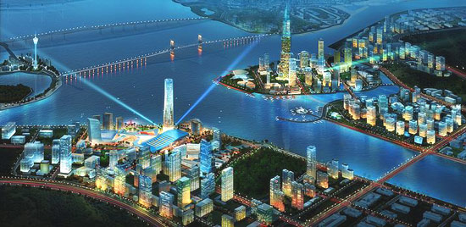
Smart Urban Park Pilot Projects
Binhai in Tianjin: Comprehensive Construction of “Three Ones”
One Network: E-government
One Centre: Cloud Centre for Governance
One Platform: Public Sharing Platform
Qianhai in Shenzhen: Central Energy Management, Infrastructure Co-Building and Sharing
Central refrigeration and heating for all buildings in the district
Co-building and sharing infrastructure: equitable access to all services
Hengqin in Zhuhai: Central Management of Pipe Systems
The establishment of a special company to manage communications pipe system
Artery pipe ducts and comprehensive cable pipe ducts
Notes:
A few highlights on smart Urban Park Projects in 2013.
Model of Tianjin Eco-City: Renewable energy will account for 20% of electricity demand (photo credit: GPA Photo)

Slide 22
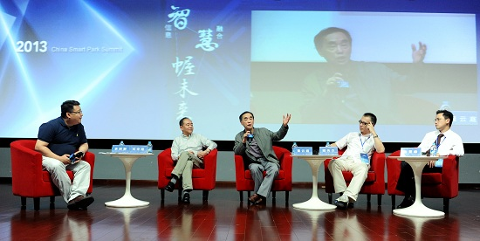
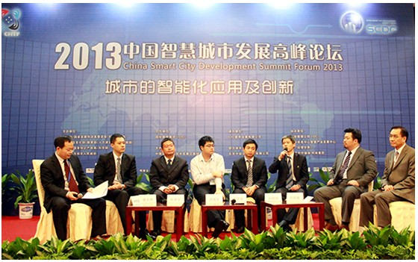
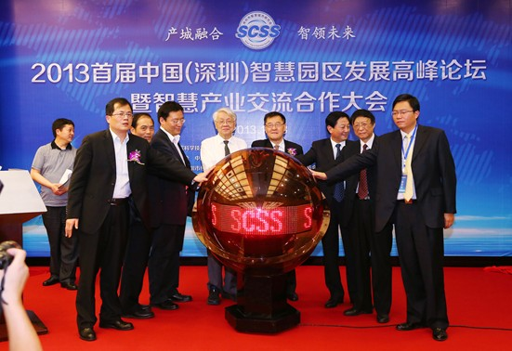
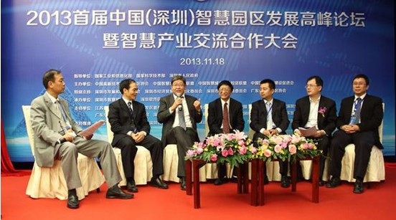
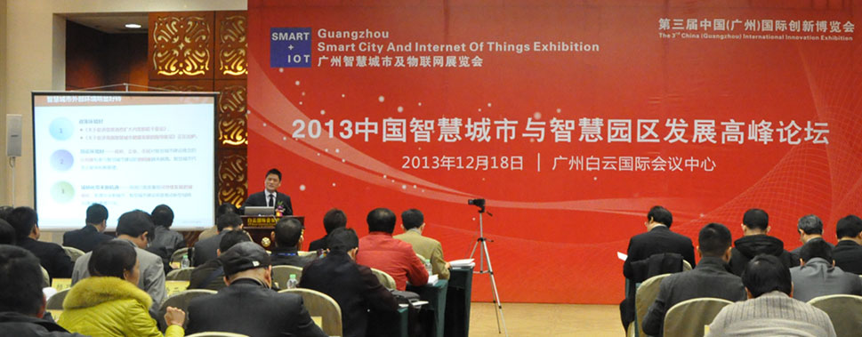
Smart Urban Park Activities in 2013
1st China (Shenzhen) Smart Park Development Summit Forum held in 18 November 2013.
2013 China Smart Urban Park Summit Forum held in Shanghai on 25 Sept 2013.
2013 China Smart City and Smart Urban Park Development Summit Forum held in Guangzhou on 18 Dec 2013.

Slide 23
Outline
An Overview of IEEE
Smart Urban Park Activities - Update on China
Smart Urban Park R&Ds at IEEE
Opportunities for Collaboration
Conclusions

Slide 24
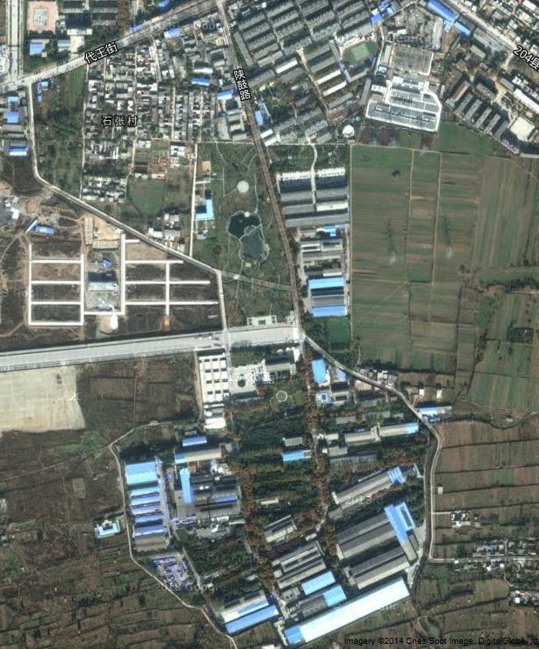
XXX Industrial Park Retrofit Project
Status Quo of Public Supply Facilities
Capacity：
2500m³/h
Exit pressure：1.6MPa
Boiler room
Sewage amount：800t/d
Temp (summer)：28 ℃
Temp (winter)：11 ℃
Water quality：Level A
Sewage treatment center
Capacity：44t/h
Supply/Return water Temp： 95/70℃
115/70 ℃
110kV Transformer substation
Tank volume : 2000m³
Water reservoir
Voltage level：110kV
Capacity：40000kVA
Natural gas station
Notes:
Problems:
1.锅炉房、污水处理布置分散，浪费土地及人力成本
2.中水利用率低，仅达到25%
3.供热形式单一，燃煤采暖排放污染大气，政府拆迁压力大
4.区域内垃圾未进行分类及资源化利用
5.当地的太阳能、地热能、水能等可再生清洁能源未得到使用
6.配置、选型、调控依靠经验，并未凭借智能计算
This technology enables the park to achieve the whole systems' optimization and enhance the energy efficiency by coupling of information and energy through the entire process of energy generation, storage, utilization, and recovery that achieves the synergy of energy input and output.

Slide 25
XXX Industrial Park Retrofit Project
Heating/Cooling Supply Facility
Boiler
One boiler supplying heat for a total area of ​​280,000 square meters
Annual consumption:
Water: 20,000 tons
Electricity: 990 000 kWh
Coal: 8500 tons
Annual emission:
CO2: 12,970 tons + SO2: 13 tons
Air conditioning
Central Cooling
Split type air conditioning

Slide 26
XXX Industrial Park Retrofit Project
Heating/Cooling Supply Facility
Water supply system
Total amount of water usage for 2013 is 635,000 tons, including:
Living area: 335,000 tons
Production area: 160,000 tons
Other: 140,000 tons
Water supply/drainage facilities
Drainage and sewage treatment systems
Daily processing capacity of sewage treatment plant: 1,200 tons
Reclaimed water used for landscaping irrigation etc., about 600 tons per day discharged to the municipal sewage system

Slide 27
XXX Industrial Park Retrofit Project
Heating/Cooling Supply Facility
Steam supply
One steam boiler station with a gas boiler (15 t) under intermittent operation
Annual consumption:
natural gas: 106,000 cubic meters
water: 5,000 tons
Water supply/drainage facilities
Steam and power supply
Power supply
One transformer substation with two 20000kVA transformers
17 low-voltage power distribution rooms
Total electricity supply in 2013: 17.17 million kWh (11.1 million kWh for production + 6 million kWh for residents)

Slide 28
XXX Industrial Park Retrofit Project
Heating/Cooling Supply Facility
Natural gas
Separate NG pipeline networks for production use and residential use
NG production capacity: 2500 m³ / h
Total NG usage in production for 2013: 790,000 cubic meters
Water supply/drainage facilities
Steam and power supply
Natural gas and solid waste
Solid waste
Production and living areas can produce 8 cubic meters of garbage per day
Food waste and organic waste can be used for anaerobic digestion or will be treated at the municipal administration and logistics centers (360 tons/year)

Slide 29
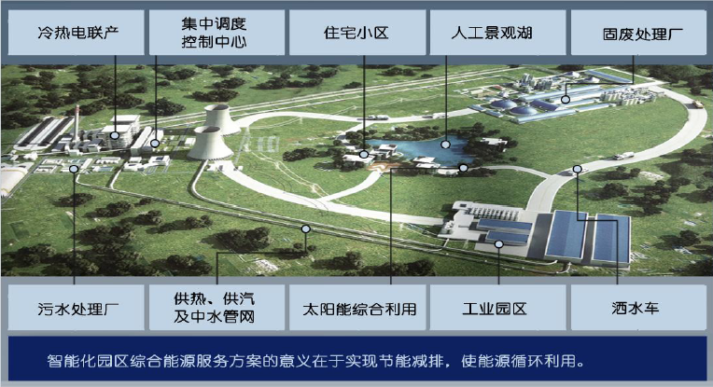
XXX Industrial Park Retrofit Project
CHP
Control Center
Residential Area
Artificial Lake
Solid Waste Treatment Plant
Sewage Treatment Plant
Heating/water Pipelines
Solar PV/Thermal
Industrial Area
EV
Integrating the sewage treatment, water recycling, solid waste utilization, and heat/steam/industrial gas providing systems to form a unified energy-saving platform, improving the urban park's overall energy efficiency with the combination of solar, biomass and other sustainable technologies.
Notes:
Integrating the sewage treatment, water recycling, solid waste utilization, and heat/steam/industrial gas providing systems to form a unified energy-saving platform, improving the park's overall energy efficiency with the combination of solar, biomass and other sustainable technologies.
This concept or technology enables the urban functional parks to achieve the whole systems' optimization and enhance the energy efficiency by coupling of information and energy through the entire process of energy generation, storage, utilization, and recovery that achieves the synergy of energy input and output.

Slide 30
XXX Industrial Park Retrofit Project
Sewage Treatment
Reclaimed Water
WSHP
1、 Sewage treatment
2、 Water reuse
3、 Solid waste treatment
4、 NG cooling/heating/steam
5、Solar PV
Sludge
GSHP
Refrigeration unit
Gas Boiler
Heating/Cooling
Supply
Anaerobic fermentation
Biogas
NG
Organic Waste
Landscape
Solar PV
Develop a multi-scale, whole-system dynamic model-based approach for the design and analysis of integrated energy systems of urban parks
Design a network infrastructure to meet a specific CO2 reduction target and minimise cost and operation problems.

Slide 31
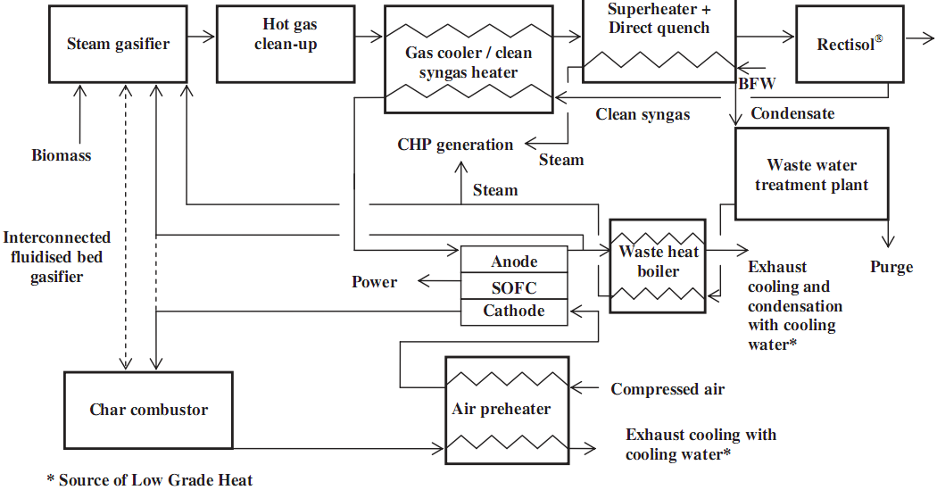
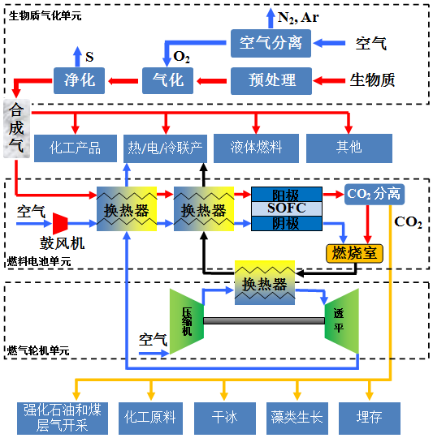
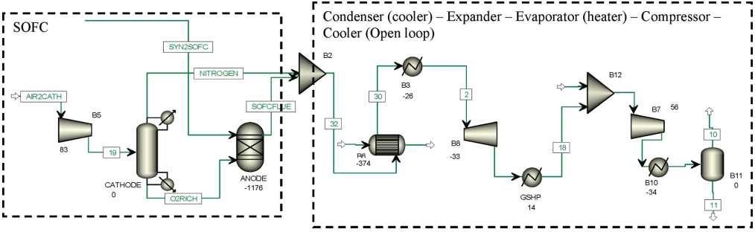
Integrated BGFC-GT Polygeneration
Zhao, Y., et. al., J. Power Sources, Vol. 196, Pages 9516-9527, 2011.
Sadhukhan, J., et.al. Industrial & Engineering Chemistry Research, Vol. 49, Pages 11506-11516, 2010.
Sadhukhan, J., et. al. Chemical Engineering Science, Vol. 65, Pages 1942-1954, 2010.
(NSFC 51206137)
Notes:
A few highlights on the modelling work being carried out at IEEE:
This is a NSFC founded project, focused on the integrated biomass gasification fuel cell - gas turbine (BGFC-GT) polygeneration technology.
Global optimization and integration strategy is introduced as a core idea to explore the key issues in system integration and optimal design of BGFC-GT via modelling and simulation.
Thermo-economic methods will be used to develop a multi-objective control theory of the system in its high efficient production, effective emission control, and cost effective operation, from a holistic point of view.

Slide 32

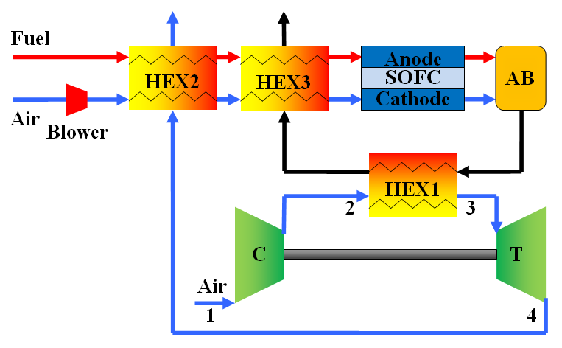
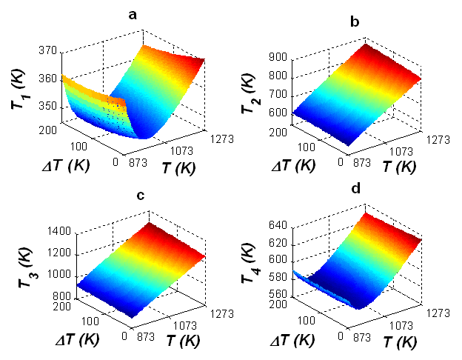
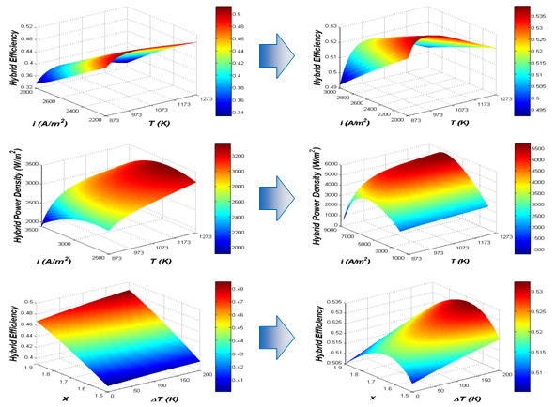
SOFC-GT Hybrid Systems
Zhao, Y., et. al. Int. J. Hydrogen Energy, Vol. 36, Pages 10235-10246, 2011.
Zhao, Y., et. al. Fuel Cells, Vol. 10, Pages 181-193, 2010.
Zhang, X., et. Al., Int. J. Hydrogen Energy, Vol. 36, Pages 15304-15312, 2011.

Slide 33
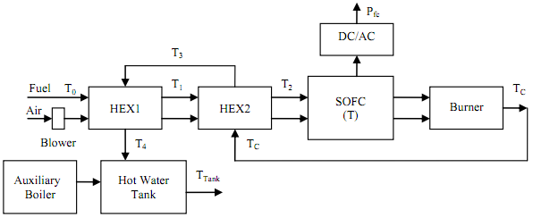
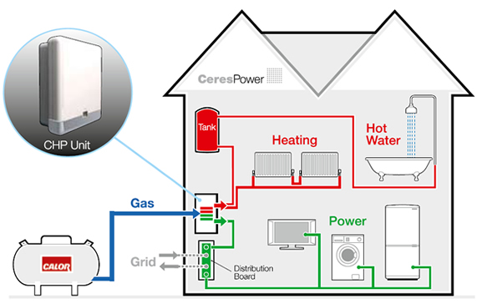
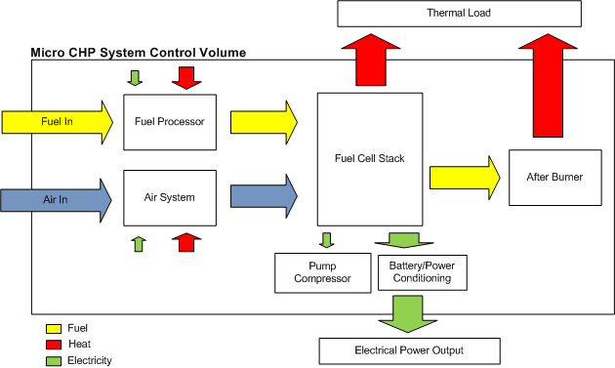
SOFC Micro-CHP for Residential Applications
Notes:
in Different Climate Zones in China
Notes:
A SOFC based Micro-CHP system coupled with a hot water storage tank is analyzed
Energy profiles of single-family households in EU countries are evaluated (single-family houses with 80 m² heated area and an average number of occupants of 2.7).
Micro-CHP ability to cover the heat and electricity demand of a house is investigate
The range of Heat-to-Power Ratio for the Micro-CHP results to be from 0.5 to 1.5.
Criteria for sizing the Micro-CHP, auxiliary boiler and hot water tank are identified.
The work being carried out in my team at IEEE is a system modelling of SOFC-CHP.
The basic concept of this SOFC CHP system is depicted in this figure, where SOFC is fueled with syngas and coupled with a hot water tank as a heat store. Air is supplied by a blower and preheated prior to entry to the SOFC. The product gas of SOFC is sent into an afterburner, where the un-reacted fuel is burnt with part of the excess air.
Two heat exchangers (HEX2 and HEX1) are adopted to serve as pre-heaters, recovering heat from the exhaust gas of the afterburner for preheating the inlet air and fuel before they enter the fuel cell. Residual heat is used to provide hot water for the home.
Extra heat can be obtained from an auxiliary boiler to cover the heat demand of the apartment. This is an option for varying the heat to-power ratio of the system, which allows the system to cover a greater portion of domestic thermal energy demand in cold cities.
The ability of a SOFC micro-CHP system to cover the heat and electricity demand of a single-family household in China is investigated.
Detailed model for CHP system is developed and analyzed, where a transient model of the hot water storage tank is used to take into account the effect of peak residential heat demand.
System design trade-offs are discussed to determine the optimal match between energy demand of the household for different climates across China and energy supply of the micro-CHP during the whole year.
Criteria for sizing system components are addressed specifically.

Slide 34
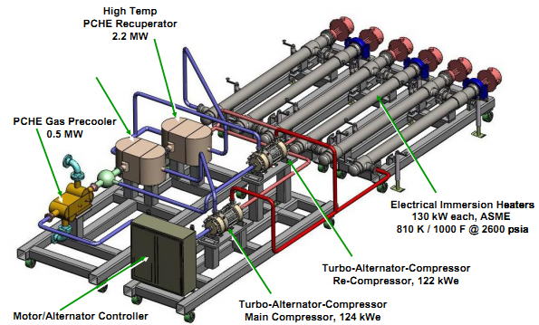
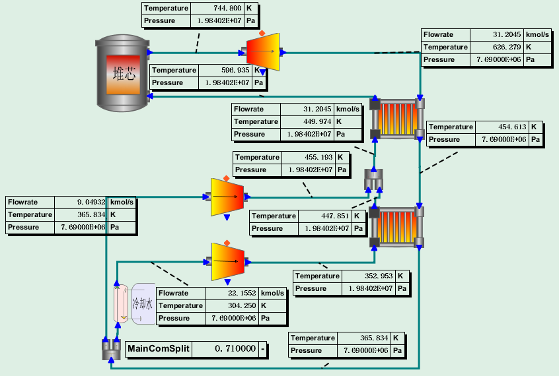
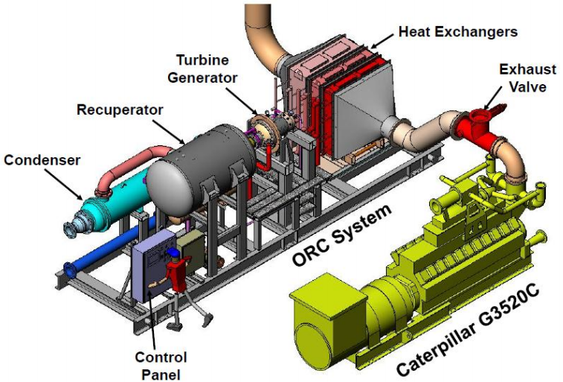
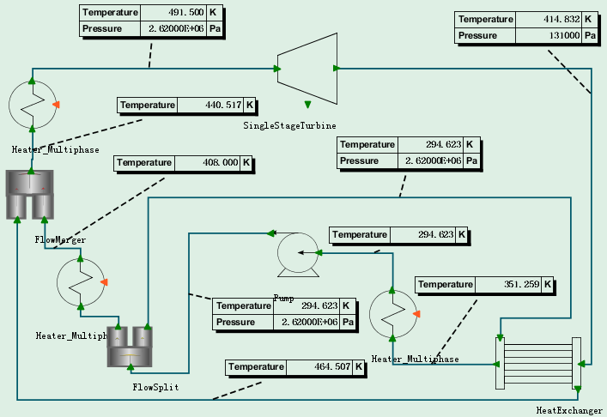
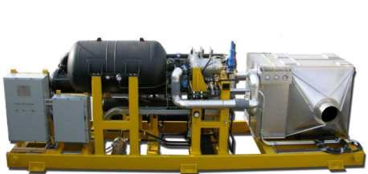
Modelling S-CO₂ Brayton Cycle and S-ORC
Notes:
Split Flow Recompression Brayton Loop at Sandia National Lab
The ORC power plant produced 350 kWe from the exhaust gases of aCaterpillar G3520C natural gas fired reciprocating engine. At the
design operating conditions (853 F exhaust gas, 425 F ORC fluid, and 60 F water cooling) the additional
350 kWe increased the power system efficiency from 38% to 45.1% representing an 18% increase in
total efficiency. (Photograph of the ORC plant as built and operated )

Slide 35
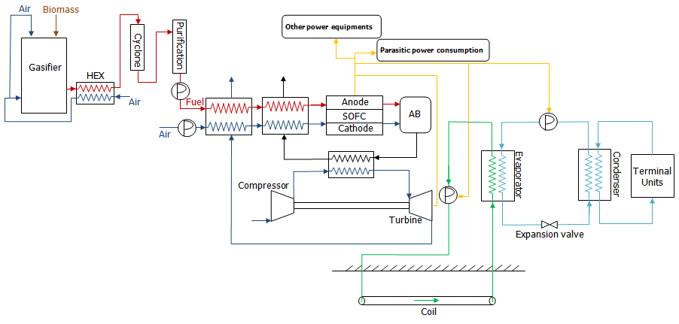
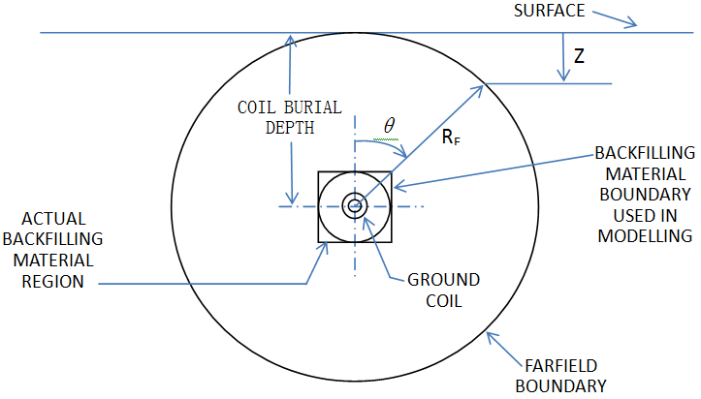
BGFC-GT-GSHP Hybrid Systems
Notes:
A three-dimensional mathematical model is developed to describe ground coil operation. The model considers the fluid flow inside the coil, coil material and size, and cyclic operation of the coil.
Diagram of ground coil.

Slide 36
Outline
An Overview of IEEE
Smart Urban Park Activities - Update on China
Smart Urban Park R&Ds at IEEE
Opportunities for Collaboration
Conclusions

Slide 37
Collaboration
Joint technology research & development projects
Joint alliance, labs or research centers
Regular information exchange (policy, regulation, science, technology, market, …)
Joint promotion/demonstration programs in both countries
…

Slide 38
Outline
An Overview of IEEE
Smart Urban Park Activities - Update on China
Smart Urban Park R&Ds at IEEE
Opportunities for Collaboration
Conclusions

Slide 39
Conclusions on IEEE SER-XMU
We are developing integrated models, methodologies and tools to understand, capture, operate and manage complex, multi-scaled energy systems.
We are developing and promoting advanced energy efficient technologies, systems and practices, with an emphasis on economically and environmentally attractive deployment.

Slide 40
Conclusions on China Smart UP RD&D
Government policy priorities
More and more pioneering cities and urban parks involving
China is still lack of sufficient smart energy infrastructures, and also lack of central incentive or other support schemes to motivate the local stakeholders
Lack of full-fledged planning at start, also practical assessment and monitoring for the baseline data and implementation
China needs to overcome barriers for Smart Urban Park development and demonstration
Smart urban park is an integrated system, therefore technology introducing and international collaborations are important
Notes:
China has recognized the importance of Smart Cities
China has been active on Smart Urban Park development and demonstration
We want to use this workshop as a platform to share experiences and best practices, stimulate funding, and promote joint research on Smart City design and urban park planning.

Slide 41
Thanks for your
attention!

Slide 42
Yingru Zhao PhD
Associate Professor in Energy Efficiency Engineering
School of Energy Research
Xiamen University
Xiamen 361005
China
yrzhao@xmu.edu.cn
http://energy.xmu.edu.cn/

